Slide 1
Analysis of Restaurants in Toronto, Ontario.
A detailed analysis of setting up a new restaurant in Toronto.

Slide 2
Introduction and Business Plan
A client wants to open a restaurant in the city on Torento, Ontario and has approached me to narrow down a locality in which he needs to set up his Business.
Our main Business Problem is that of choosing the right location. For us to choose the right location we will be needing information regarding various neighbourhoods of Toronto. Choosing the right location implies setting up shop where "Competition" is relatively less and footfall is relatively more. So our focus should be setting up shop in an area which has the following attributes :
Locality where there are relatively less number of Restaurants.
Locality close to Colleges, Schools and Work Places(Offices) as our main footfall will come from Students and Office personnel.
In order to maximize profitability you have got to find the right 'Spot' and my project does exactly the same.

Slide 3
Data Sets.
Localities of Toronto, Ontario from the Wikipedia page: https://en.wikipedia.org/wiki/List_of_postal_codes_of_Canada:_M.
From the above wikipedia page I will extract relevant infornmation, particularly information regarding various Neighbourhoods, Boroughs and Postal Codes of the city of Toronto.
Geographical coordinates of each postal code: http://cocl.us/Geospatial_data
Data regarding the coordinates i.e. (latitude & longitude) to the above Neighbourhoods of Toronto will be extracted from the above link.
I will be using Foursquare for the most important part of the project, that is collecting data regarding the location. (Location Data)
Foresquare will help me find the following:
Restaurants of nearby neighborhoods.
Office spaces of nearby neighborhoods.
Schools of nearby neighborhoods.
Colleges of nearby neighborhoods’.
Once we have all our data with us with the help of the Pandas library I will create a neat little Data Frame.
Leveraging the Data Frame at hand I will determine which neighborhood will be the most appropriate for my client to set up his restaurant.

Slide 4
Methodology
For each neighborhood all the offices, schools, colleges and restaurants data have been collected from Foursquare.
Given these neighborhoods, I have calculated the sum of office, school, colleges and restaurants.
Now that we have four categories namely “Schools”, “Restaurants”, “Colleges”, and “Offices” a weight (penalty) has been assigned to each one of them.
Restaurants have been assigned a weight of (-1), as I want to avoid locating my clients restaurant close to any other restaurant.
Schools have been assigned a weight of (+1), as I consider students an average customers.
Universities have been assigned a weight of (+1.5), because lets’ face it, college students are perpetually hungry.
Offices have been assigned a weight of (+2), because I consider office employees my best customers.
Given the weights assigned to each category, a score was computed for each neighborhood as the weighted sum of the number of venues in each of the four categories.

Slide 5
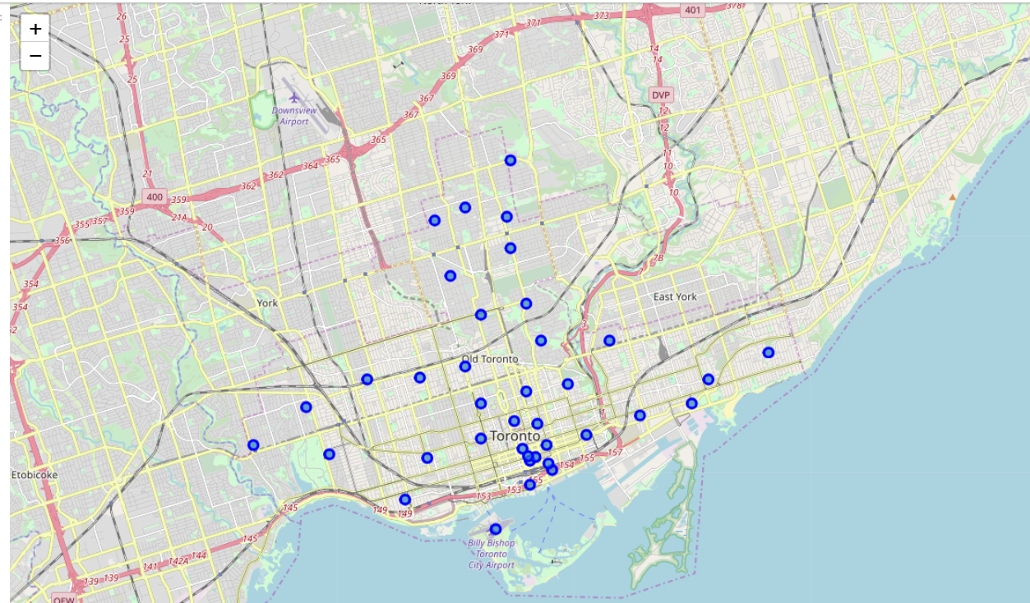
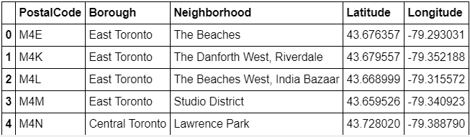
Neighborhoods of Toronto, Ontario.

Slide 6
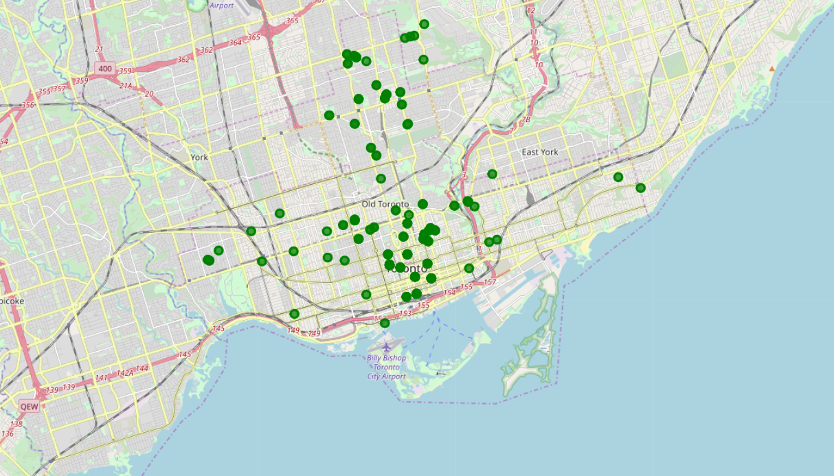
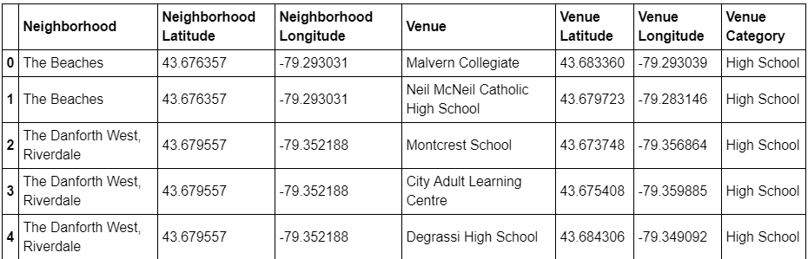
High Schools of Toronto, Ontario.

Slide 7
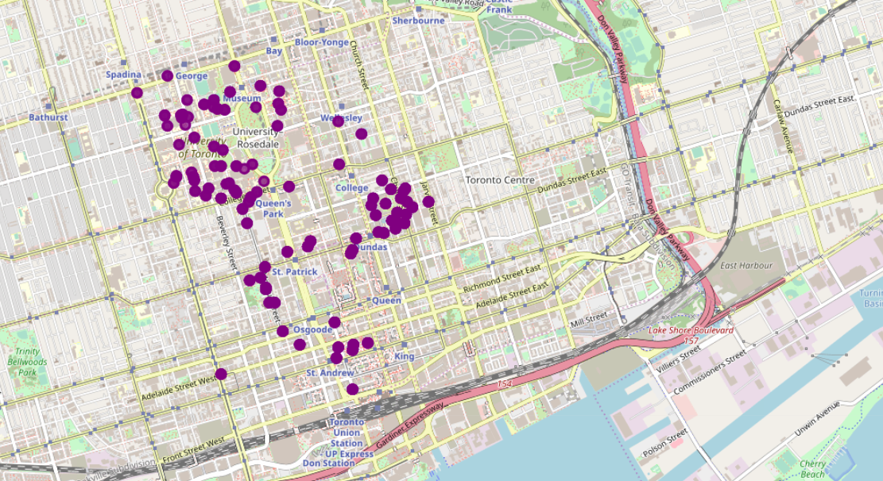
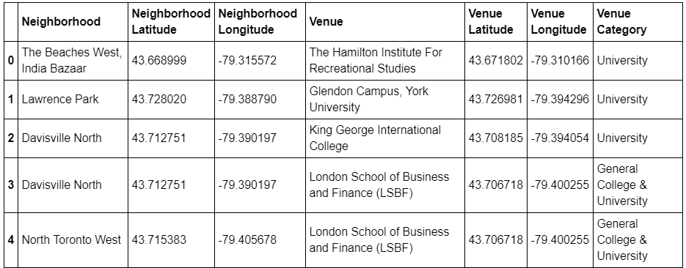
Universities of Toronto, Ontario.

Slide 8
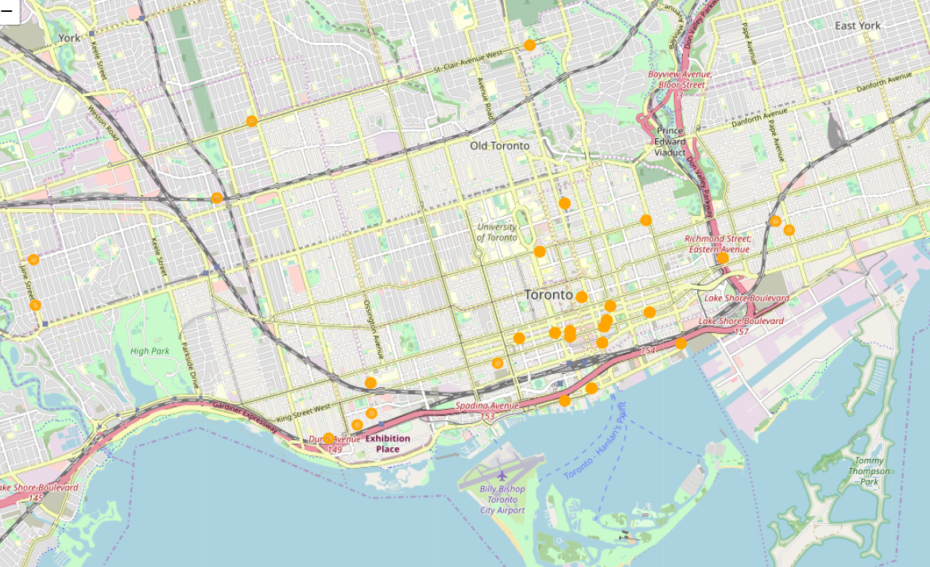
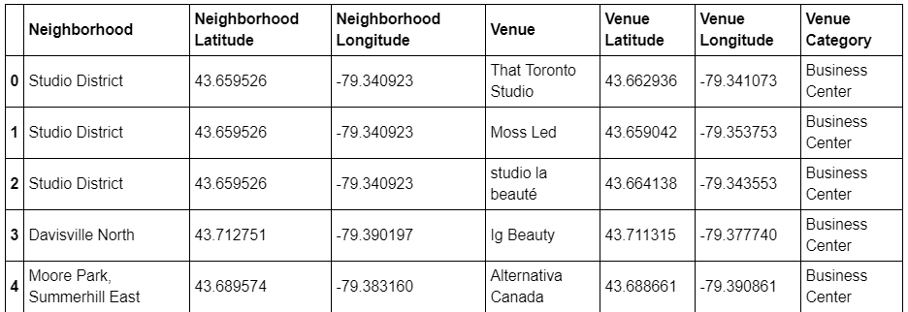
Offices of Toronto, Ontario.

Slide 9
Results
After our analysis we come to a conclusion that the neighborhood of “Central Bay Street” is the best location to set up a restaurant business as it is close in proximity to schools, colleges, universities and offices and with the highest score of 97.5.
Setting up a restaurant in this neighborhood will surely maximize the number of customers rather than setting up a restaurant in some other neighborhood.
“Bay Street” was originally known as Bear Street because of frequent bear sightings in the early history of Toronto. It was renamed Bay Street in 1797 from the fact that it connected Lot Street (present-day Queen Street West) to a bay at the Toronto Harbour.
Bay Street is a major thoroughfare in Downtown Toronto, Ontario, Canada. It is frequently used as a metonym to refer to Toronto's Financial District and the Canadian financial sector as a whole, similar to Wall Street in the United States.
I have provided a snapshot of the top score of neighborhoods to set up a restaurant.
Along with the snapshot of the best score I have provided a map that shows us the best location to set up our restaurant.
In the map, the “Blue marker” is the neighborhood that is most suitable to set up my clients restaurant.

Slide 10
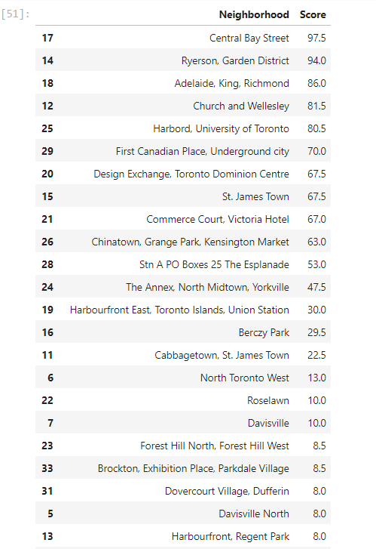
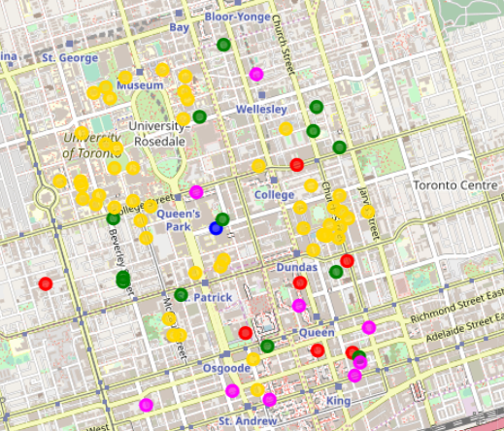
Recommended localities. Toronto, Ontario.

Slide 11
Conclusion
In this project I aimed to analyze the best spot to open a restaurant in Toronto, Ontario. For this I considered various datasets that were all available online. Using weighted means approach I came to a conclusion that “Central Bay Street” is best the neighborhood to set up a restaurant as it would receive maximum number of footfall.

Slide 12
THANK YOU
-KEVIN PANT

